Slide 1
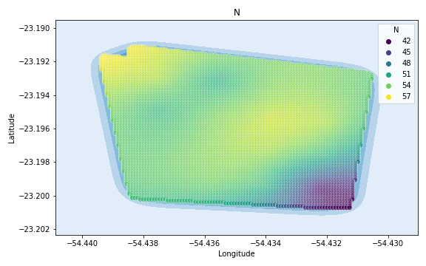
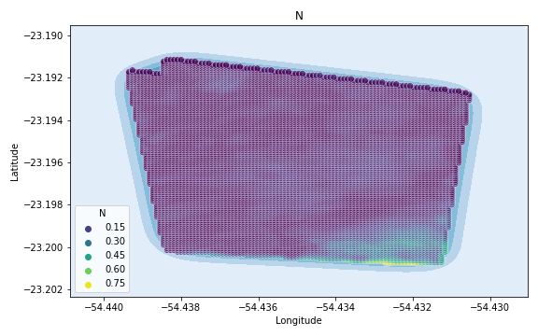
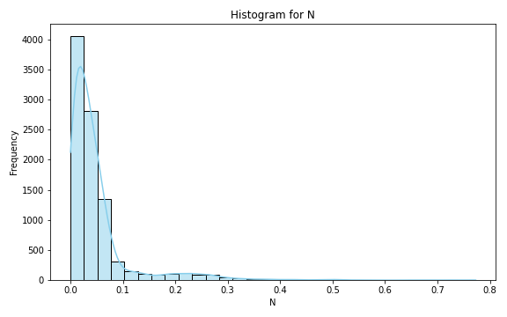
Analysis for column: N Model: Random Forest
Statistics:
mean 0.021840
std 0.027524
min 0.000006
25% 0.006134
50% 0.013517
75% 0.025553
80% 0.029431
85% 0.035900
90% 0.047641
95% 0.078061
99% 0.138726

Slide 2
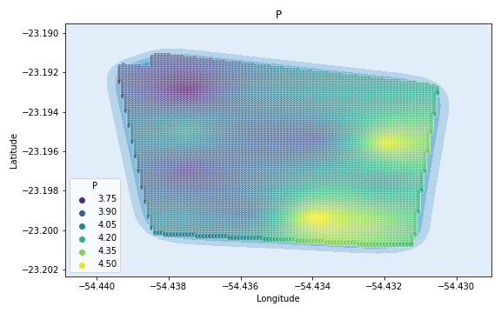
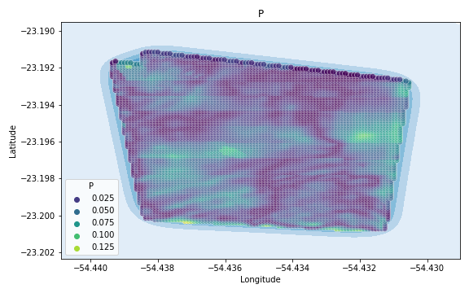
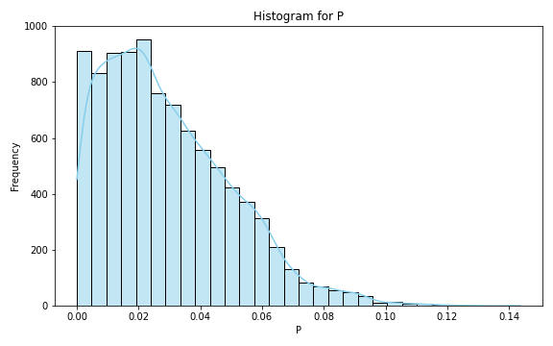
Analysis for column: P Model: Random Forest
Statistics:
mean 0.025855
std 0.021761
min 0.000001
25% 0.008492
50% 0.020261
75% 0.037597
80% 0.042588
85% 0.048464
90% 0.057679
95% 0.071307
99% 0.089897

Slide 3
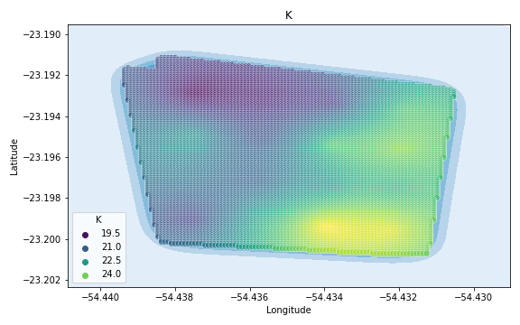
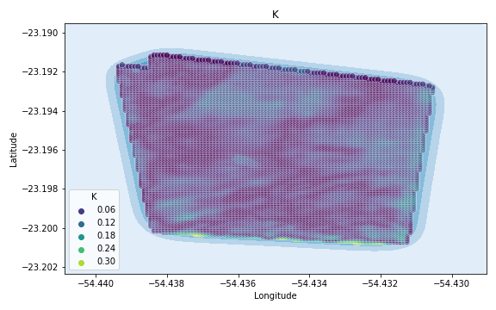
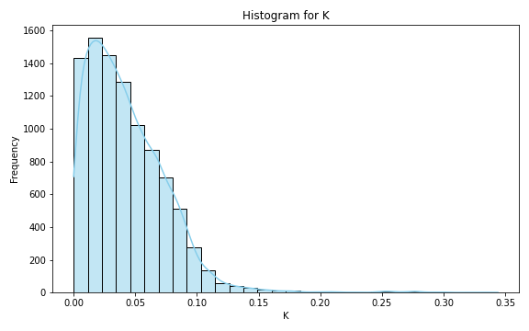
Analysis for column: K Model: Random Forest
Statistics:
mean 0.038611
std 0.031374
min 0.000005
25% 0.012093
50% 0.031644
75% 0.059397
80% 0.066461
85% 0.073611
90% 0.082915
95% 0.099195
99% 0.126953

Slide 4
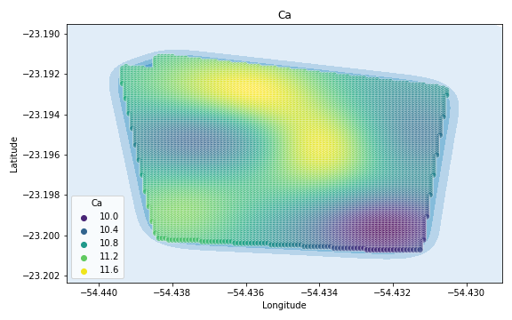
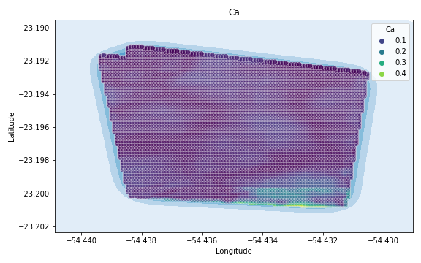
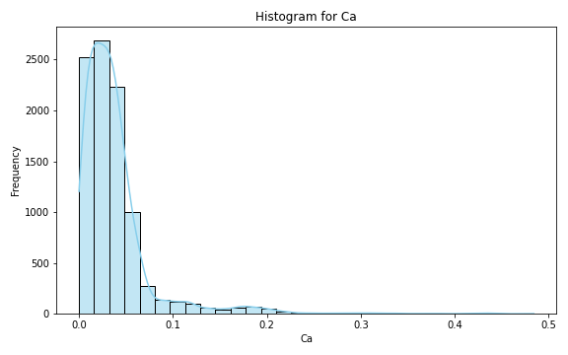
Analysis for column: Ca Model: Random Forest
Statistics:
mean 2.250761e-02
std 1.702944e-02
min 9.845177e-07
25% 8.704759e-03
50% 1.877407e-02
75% 3.294000e-02
80% 3.654751e-02
85% 4.142881e-02
90% 4.690297e-02
95% 5.539798e-02
99% 6.947492e-02

Slide 5
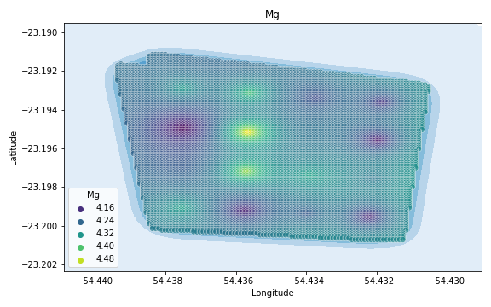
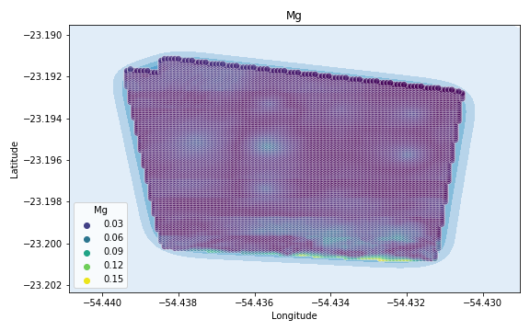
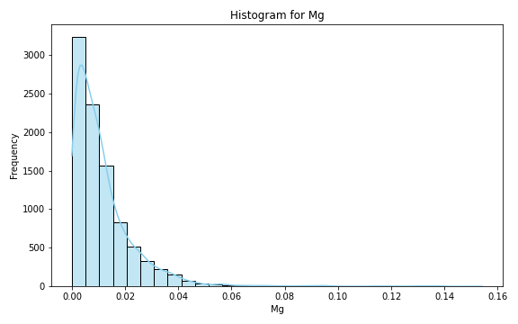
Analysis for column: Mg Model: Random Forest
Statistics:
mean 0.006949
std 0.006216
min 0.000002
25% 0.002233
50% 0.005413
75% 0.009726
80% 0.011096
85% 0.012779
90% 0.015223
95% 0.019351
99% 0.028658

Slide 6
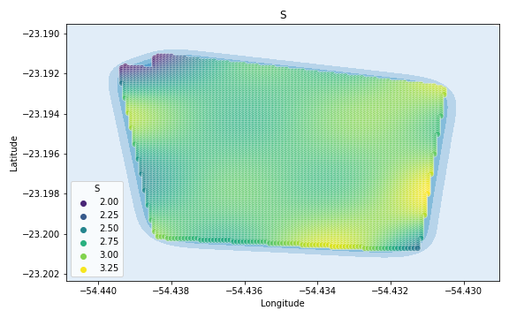
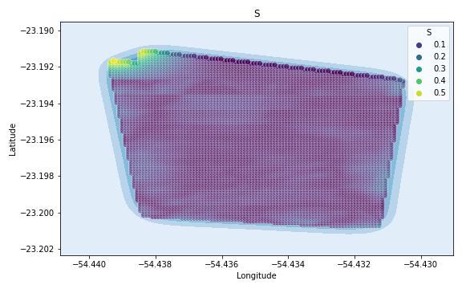
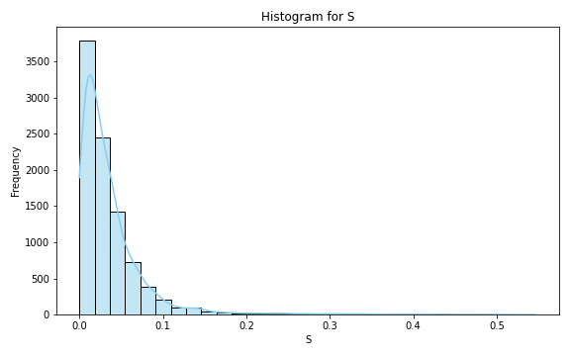
Analysis for column: S Model: Random Forest
Statistics:
mean 0.038236
std 0.052268
min 0.000002
25% 0.010351
50% 0.023630
75% 0.044604
80% 0.051999
85% 0.064044
90% 0.083873
95% 0.120580
99% 0.283595

Slide 7
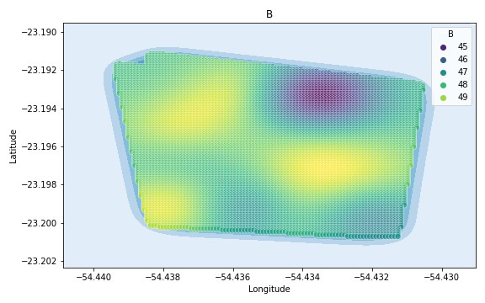
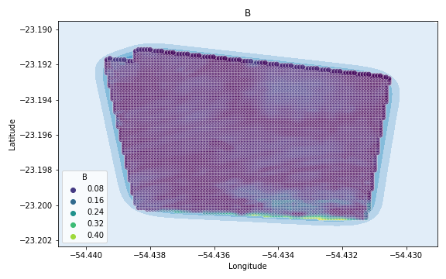
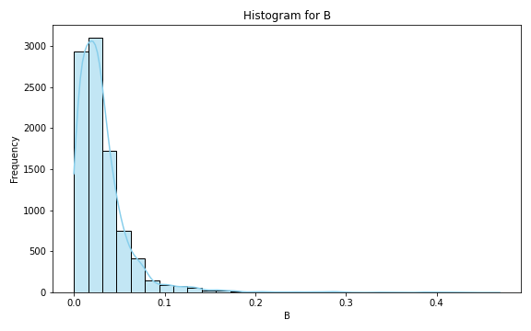
Analysis for column: B Model: Random Forest
Statistics:
mean 0.018074
std 0.017052
min 0.000002
25% 0.006090
50% 0.013302
75% 0.023924
80% 0.027201
85% 0.032189
90% 0.040569
95% 0.055233
99% 0.079959

Slide 8
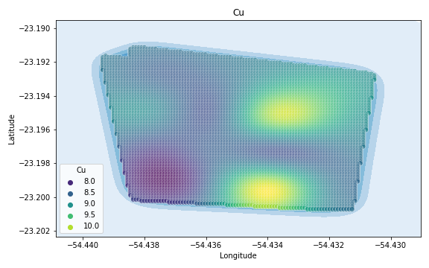
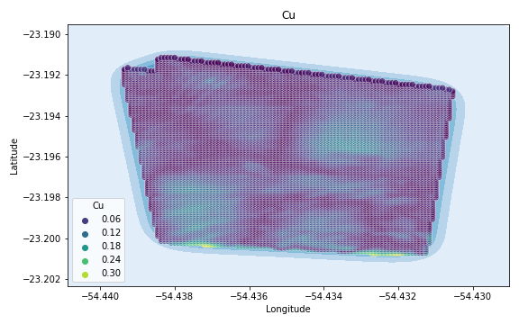
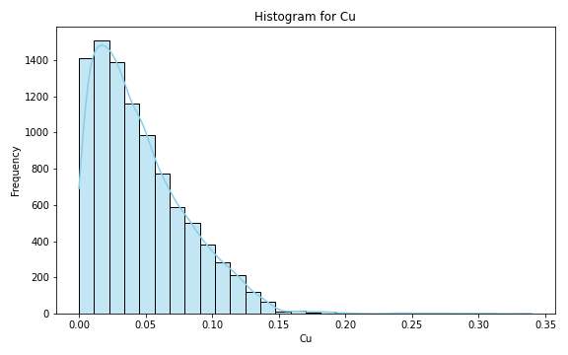
Analysis for column: Cu Model: Random Forest
Statistics:
mean 0.045365
std 0.038952
min 0.000005
25% 0.014486
50% 0.033169
75% 0.069599
80% 0.079396
85% 0.090417
90% 0.102950
95% 0.121646
99% 0.158251

Slide 9
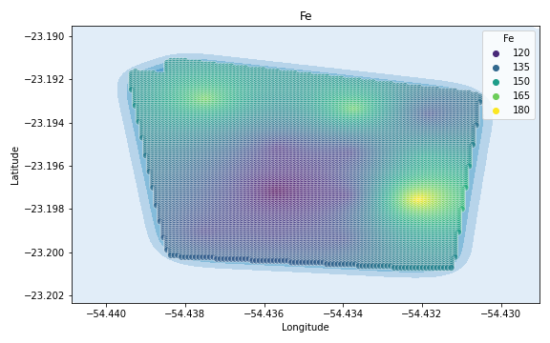
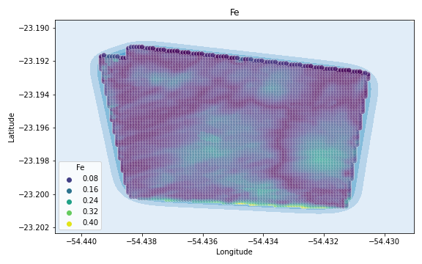
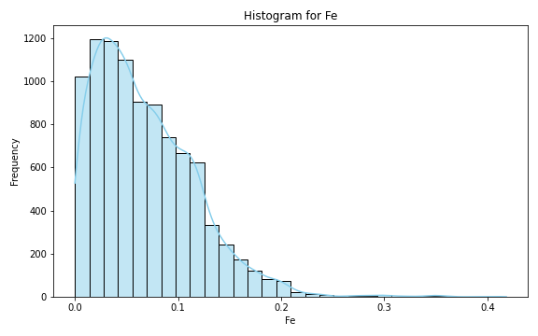
Analysis for column: Fe Model: Random Forest
Statistics:
mean 0.058659
std 0.048645
min 0.000009
25% 0.020220
50% 0.045617
75% 0.086226
80% 0.097090
85% 0.110987
90% 0.127720
95% 0.157735
99% 0.206475

Slide 10
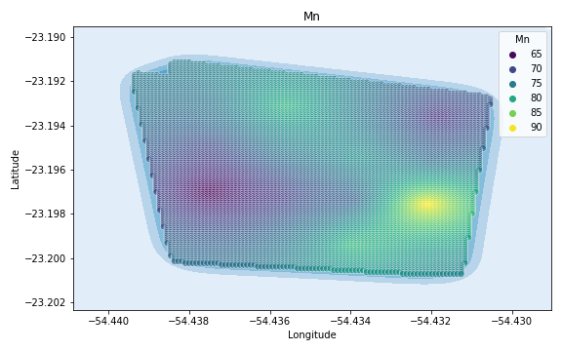
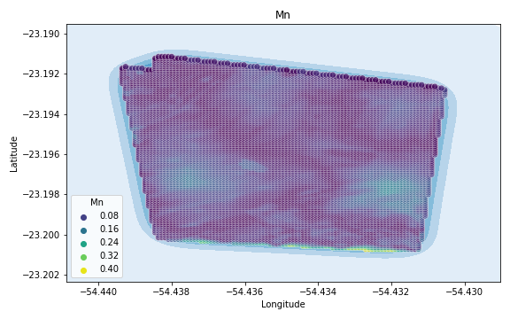
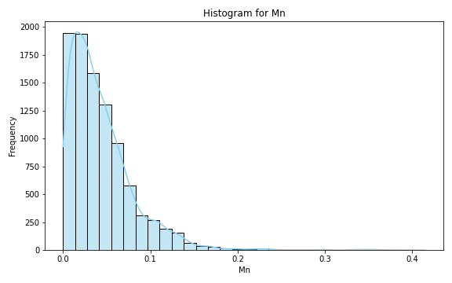
Analysis for column: Mn Model: Random Forest
Statistics:
mean 0.037756
std 0.033354
min 0.000005
25% 0.012436
50% 0.028292
75% 0.054250
80% 0.062009
85% 0.071561
90% 0.083145
95% 0.106712
99% 0.146583

Slide 11
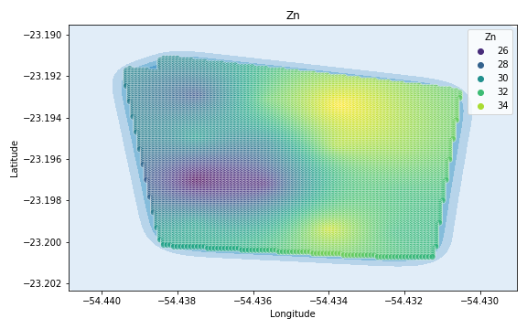
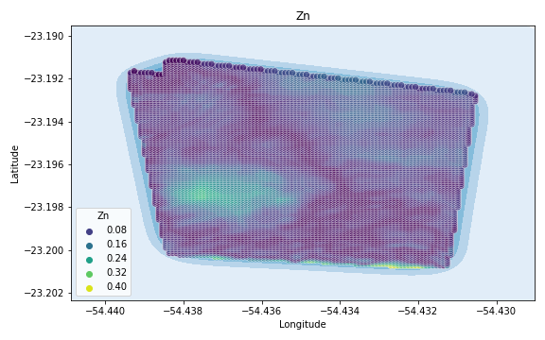
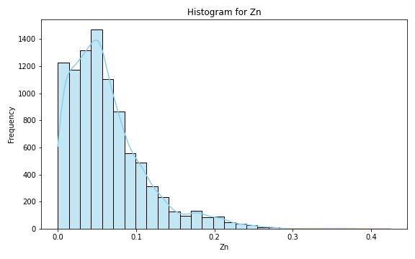
Analysis for column: Zn Model: Random Forest
Statistics:
mean 0.061378
std 0.056159
min 0.000008
25% 0.017411
50% 0.046113
75% 0.089468
80% 0.100913
85% 0.116235
90% 0.135413
95% 0.172622
99% 0.251546

Slide 12
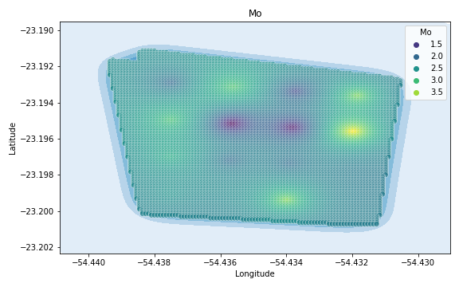
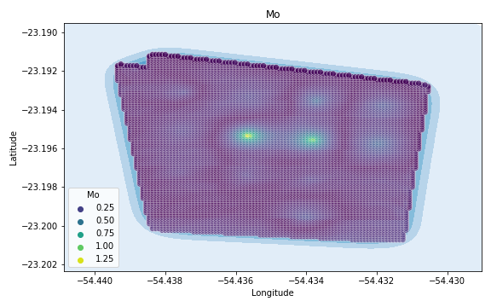
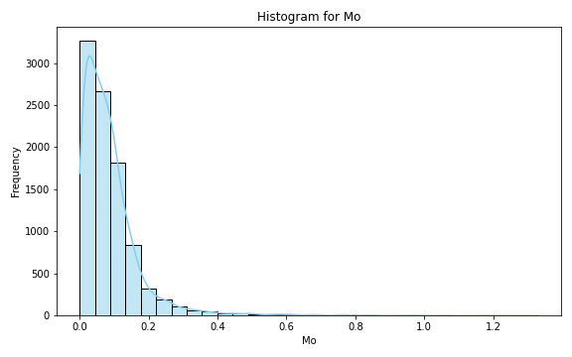
Analysis for column: Mo Model: Random Forest
Statistics:
mean 0.082011
std 0.090602
min 0.000005
25% 0.023288
50% 0.057754
75% 0.109556
80% 0.124946
85% 0.146293
90% 0.175784
95% 0.240281
99% 0.432721

Slide 13
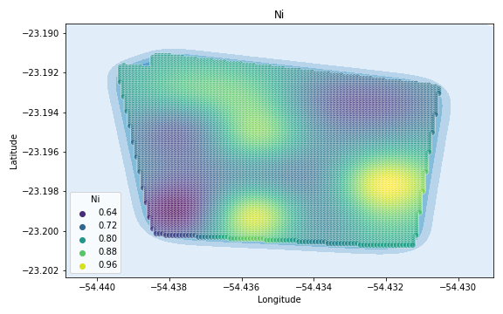
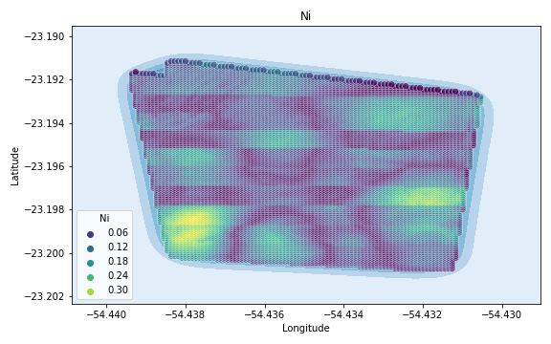
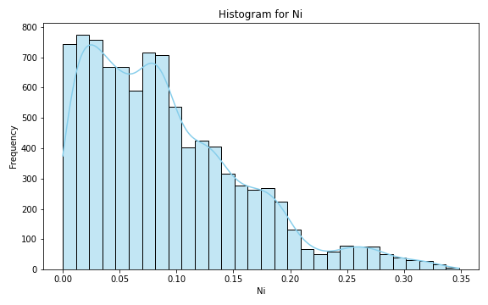
Analysis for column: Ni Model: Random Forest
Statistics:
mean 0.077602
std 0.067941
min 0.000012
25% 0.026315
50% 0.057646
75% 0.110500
80% 0.128562
85% 0.148458
90% 0.175789
95% 0.214517
99% 0.294735

Slide 14
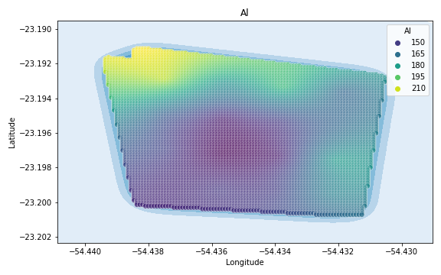
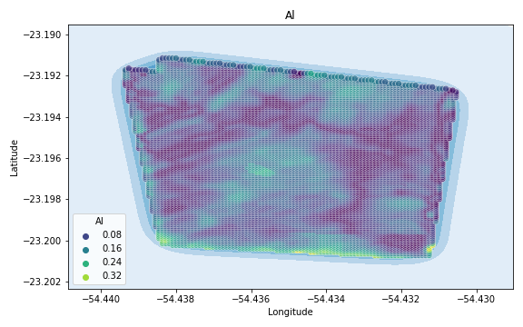
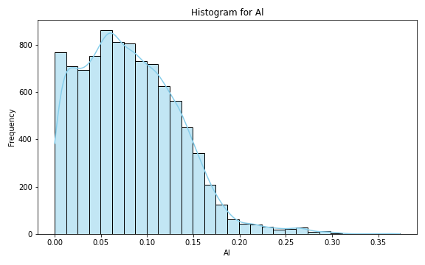
Analysis for column: Al Model: Random Forest
Statistics:
mean 0.070174
std 0.050962
min 0.000002
25% 0.029197
50% 0.061561
75% 0.101972
80% 0.111696
85% 0.124187
90% 0.138664
95% 0.160705
99% 0.224482

Slide 15
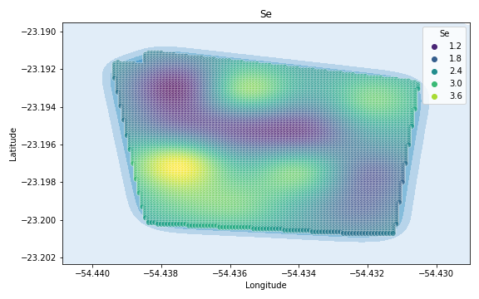
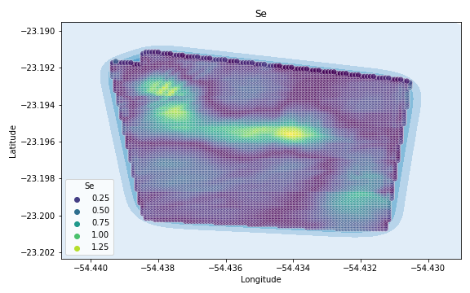
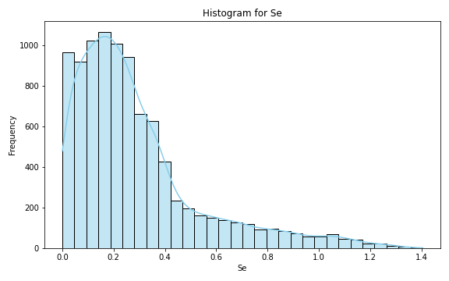
Analysis for column: Se Model: Random Forest
Statistics:
mean 0.263108
std 0.250827
min 0.000104
25% 0.089565
50% 0.193356
75% 0.347873
80% 0.399789
85% 0.471116
90% 0.575833
95% 0.780714
99% 1.213428

Slide 16
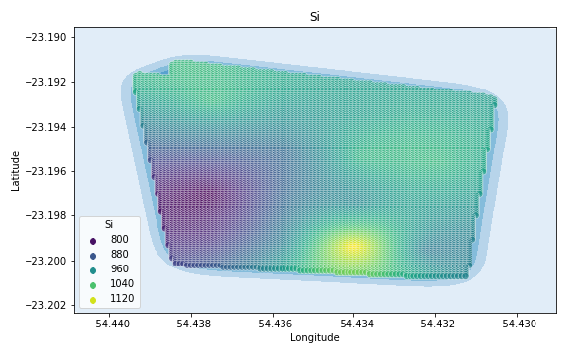
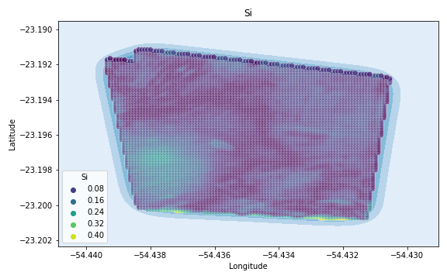
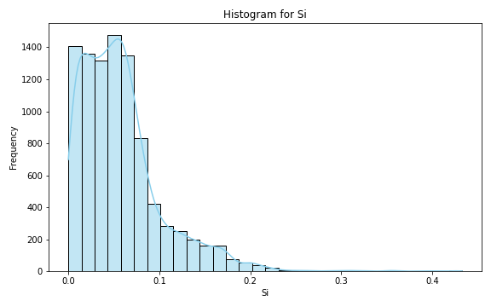
Analysis for column: Si Model: Random Forest
Statistics:
mean 0.055204
std 0.047886
min 0.000017
25% 0.018531
50% 0.042155
75% 0.077635
80% 0.088787
85% 0.103726
90% 0.122608
95% 0.153269
99% 0.214549

Slide 17
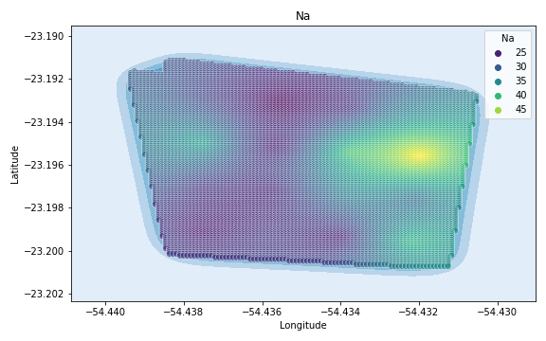
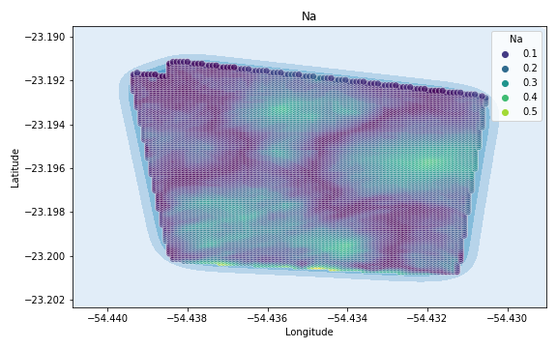

Analysis for column: Na Model: Random Forest
Statistics:
mean 0.132937
std 0.104569
min 0.000031
25% 0.046440
50% 0.110770
75% 0.198747
80% 0.220550
85% 0.245274
90% 0.279297
95% 0.330298
99% 0.443892

Slide 18



Analysis for column: Va Model: Random Forest
Statistics:
mean 0.089095
std 0.080898
min 0.000003
25% 0.027307
50% 0.064319
75% 0.128575
80% 0.150007
85% 0.177667
90% 0.210743
95% 0.255470
99% 0.335310

Slide 19



Analysis for column: DRIS_N Model: Random Forest
Statistics:
mean 0.225015
std 0.193556
min 0.000006
25% 0.077515
50% 0.178100
75% 0.321953
80% 0.364073
85% 0.416598
90% 0.482086
95% 0.588783
99% 0.871479

Slide 20



Analysis for column: DRIS_P Model: Random Forest
Statistics:
mean 0.258701
std 3.216349
min 0.000013
25% 0.058270
50% 0.127744
75% 0.225651
80% 0.251622
85% 0.294502
90% 0.361685
95% 0.566998
99% 1.670731

Slide 21



Analysis for column: DRIS_K Model: Random Forest
Statistics:
mean 2.537544
std 76.486352
min 0.000092
25% 0.146708
50% 0.373743
75% 0.874116
80% 1.175816
85% 1.670163
90% 2.454742
95% 4.226033
99% 17.548958

Slide 22



Analysis for column: DRIS_Ca Model: Random Forest
Statistics:
mean 1.040402
std 11.030192
min 0.000120
25% 0.090936
50% 0.226005
75% 0.507571
80% 0.660063
85% 0.959036
90% 1.732633
95% 3.050871
99% 10.973409

Slide 23



Analysis for column: DRIS_Mg Model: Random Forest
Statistics:
mean 0.140965
std 0.146146
min 0.000005
25% 0.043237
50% 0.099291
75% 0.185269
80% 0.212578
85% 0.245862
90% 0.300901
95% 0.438307
99% 0.735713

Slide 24



Analysis for column: DRIS_S Model: Random Forest
Statistics:
mean 5.828664
std 182.169240
min 0.000274
25% 0.306038
50% 0.686159
75% 1.431946
80% 1.831662
85% 2.368173
90% 3.336811
95% 7.081803
99% 29.686885

Slide 25



Analysis for column: DRIS_B Model: Random Forest
Statistics:
mean 0.316770
std 0.437033
min 0.000074
25% 0.070674
50% 0.174389
75% 0.356105
80% 0.420164
85% 0.542305
90% 0.767594
95% 1.188299
99% 2.299834

Slide 26



Analysis for column: DRIS_Cu Model: Random Forest
Statistics:
mean 0.071038
std 0.061933
min 0.000012
25% 0.022625
50% 0.054525
75% 0.103154
80% 0.117014
85% 0.135063
90% 0.159048
95% 0.198311
99% 0.266537

Slide 27



Analysis for column: DRIS_Fe Model: Random Forest
Statistics:
mean 0.218980
std 0.191238
min 0.000018
25% 0.075743
50% 0.162492
75% 0.315416
80% 0.363961
85% 0.419739
90% 0.482142
95% 0.580710
99% 0.864794

Slide 28



Analysis for column: DRIS_Mn Model: Random Forest
Statistics:
mean 0.230149
std 0.219537
min 0.000011
25% 0.074131
50% 0.172119
75% 0.313716
80% 0.364993
85% 0.427591
90% 0.504757
95% 0.655922
99% 1.018587

Slide 29



Analysis for column: DRIS_Zn Model: Random Forest
Statistics:
mean 0.260300
std 0.241183
min 0.000019
25% 0.080545
50% 0.198033
75% 0.363515
80% 0.414681
85% 0.474547
90% 0.558387
95% 0.724387
99% 1.148800

Slide 30



Analysis for column: IMS Model: Random Forest
Statistics:
mean 0.259640
std 0.261075
min 0.000030
25% 0.064825
50% 0.180684
75% 0.359773
80% 0.416984
85% 0.506837
90% 0.611102
95% 0.822048
99% 1.172437

Slide 31



Analysis for column: IBN Model: Random Forest
Statistics:
mean 0.074519
std 0.064047
min 0.000008
25% 0.025016
50% 0.056648
75% 0.106592
80% 0.120544
85% 0.140863
90% 0.165527
95% 0.204980
99% 0.274736

